Slide 1
Call to Action!
Presentation to league of women Voters
January 28, 2017

Slide 2
So what are the solutions?
Land and Land Use
Money
Change the Conversation
Innovation

Slide 3
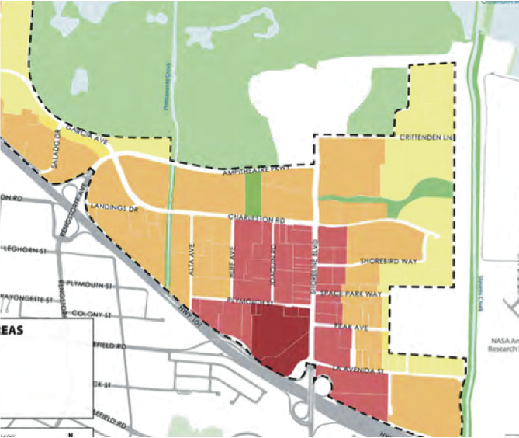
Land and Land Use
Publicly Owned Land
Specific and Precise Plans
General Plans

Slide 4
money
MEASURE A, MEASURE A1, AND MEASURE K!!!
New Regional Revenue Sources
Impact Fees

Slide 5
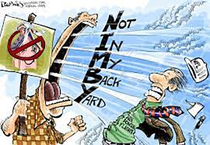
CHANGE THE CONVERSATION
Education and Information
Communication
Messaging
Notes:
Voters in Santa Clara counties approved a $950 million bond in November, and generally support new housing development, especially affordable housing in surveys.
While people generally support affordable housing, they aren’t always supportive when it’s in their neighborhood.
However, when it comes to housing near them, it’s a different story.

Slide 6
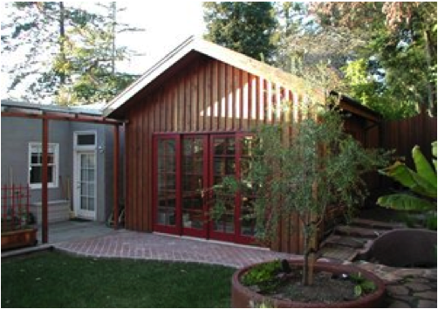
Innovation
Second Units
Micro Units (smaller units)
Innovative Housing Types and Construction Methods

Slide 7
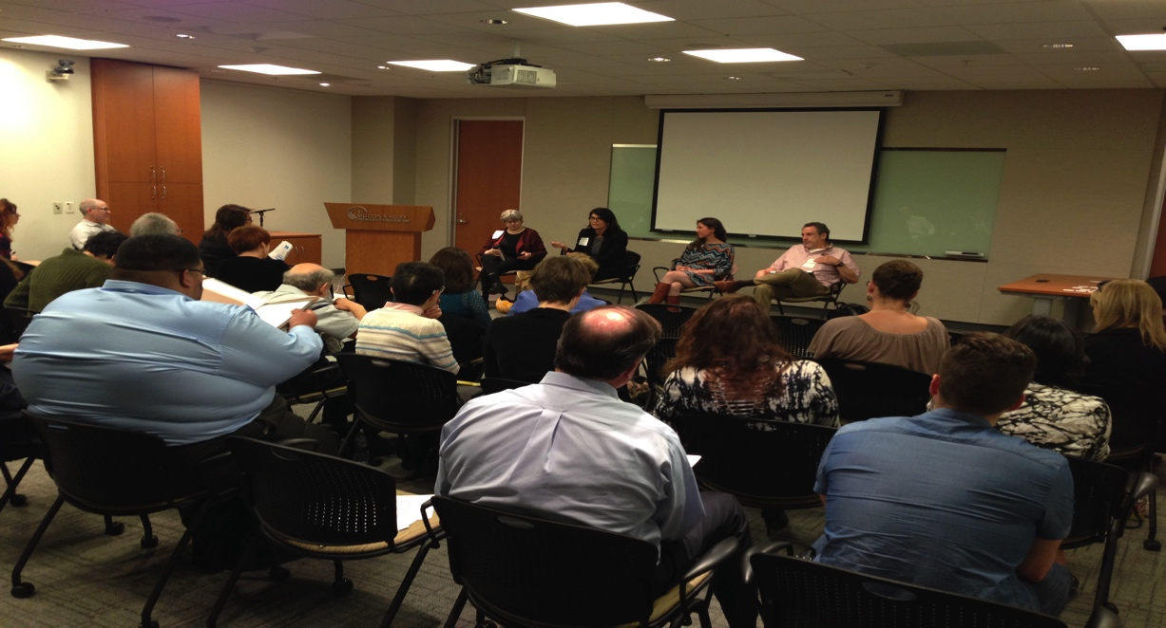
approach
Collaboration
Community Engagement
Foundation-- Education and Information
Advocacy

Slide 8
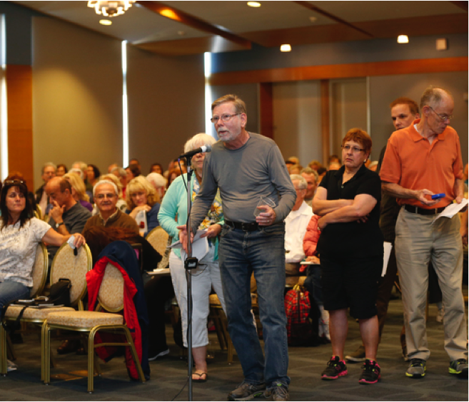
action!!
Measure A Implementation-- Housing Ready Communities
New Policy and Funding Sources
Grassroots Advocacy

Slide 9
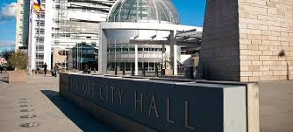
Call to action
League participation in collaboration
Individual support for projects, policies, programs
Talk to your neighbors
Talk to your elected officials
Write letters
Come to meetings

Slide 10
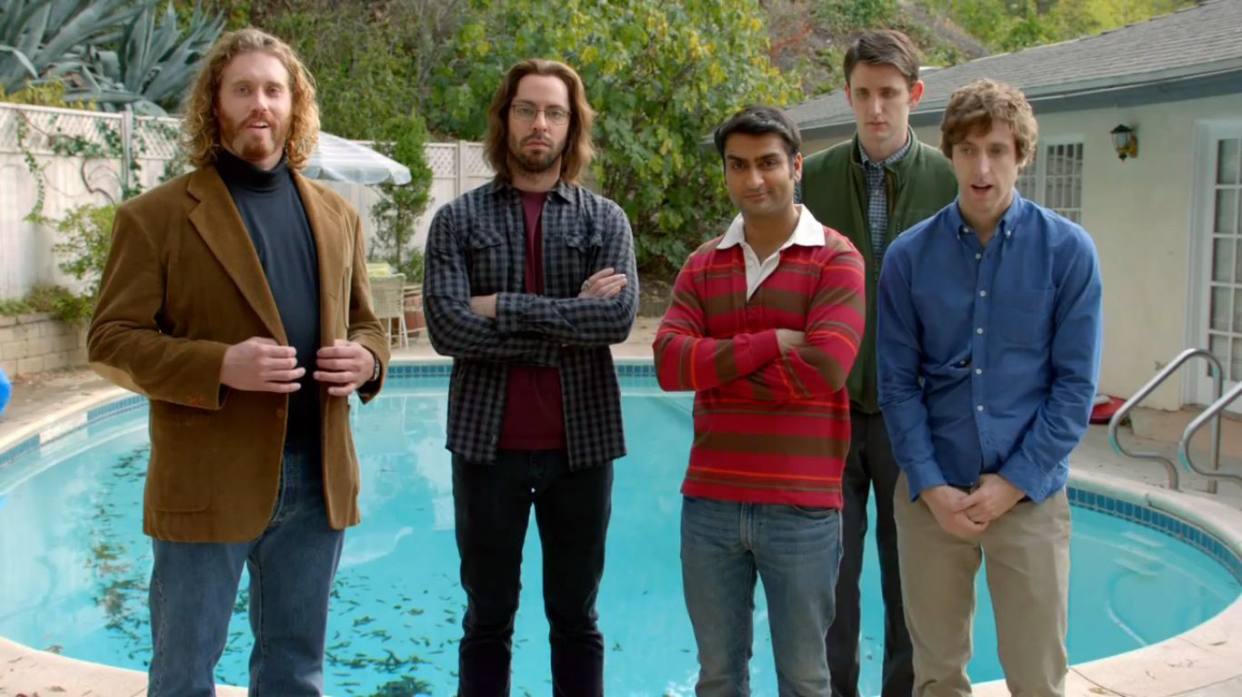
Join Us!
Like us on Facebook– sili siliconvalleyathome
Follow us on Twitter— sv svatthome
Sign up for our Newsletter—www.siliconvalleyathome.org
Join as a member!
Email me!-- leslye@siliconvalleyathome.org

