Slide 1
Bay Area Council Housing & Sustainable Development
Matt Regan
Senior Vice President of Public Policy
Bay Area Council

Slide 2
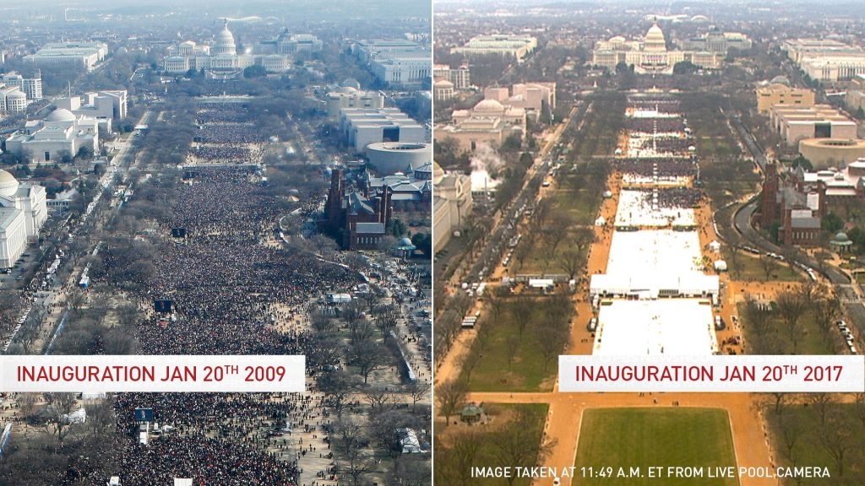
Notes:
As you can clearly see the crowd on the right is much bigger than the crowd on the left. This is called an “alternative fact”

Slide 3
Annual New Housing Permits Statewide 1955-2015
1955-1989
Average 205,000
2006-2015
Average 80,000
Source: Construction Industry Research Board/California Homebuilding Foundation Reports 2005, 2013, 2015; Graphic by HCD
Notes:
As you can see from these housing production numbers we are clearly in a building boom! There are cranes everywhere, developers are reaping huge profits paving over every square inch of California, we need to slow down! we need a moratorium! all this rampant construction is causing displacement! This too is “an alternative fact”. We are, in reality, at historic low levels of housing production and far below what we need to produce to meet population growth. Displacement is simply a product of supply not meeting demand.

Slide 4
San Francisco Vs Seattle
Notes:
This comparison recently produced by the San Francisco Housing Action Coalition shows how San Francisco is faring compared to Seattle, and let us not forget that the City of Seattle is home to about 25% fewer people than San Francisco. We are underperforming in historical terms and when compared to peer economies.

Slide 5
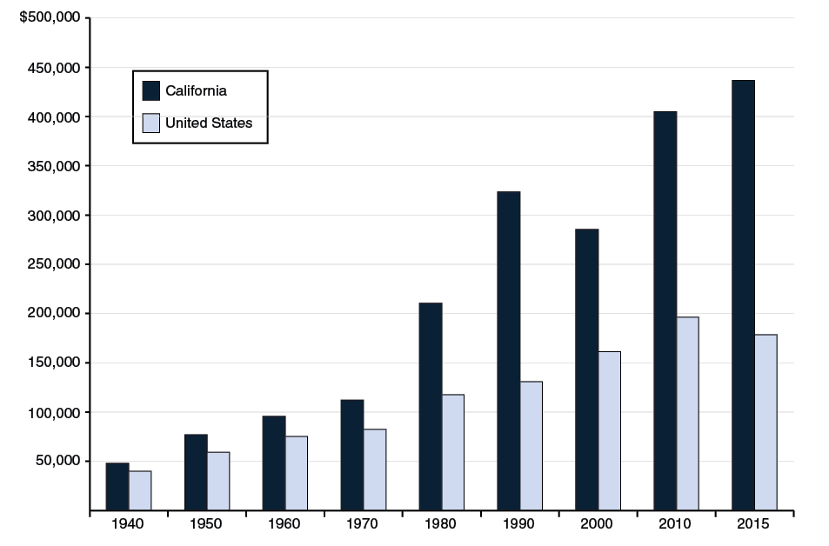
California is Expensive!
Source: Legislative Analyst’s Office
Notes:
Why? Occam’s Razor…the most obvious answer is usually the correct one. When you have huge demand and little supply, prices go up.

Slide 6
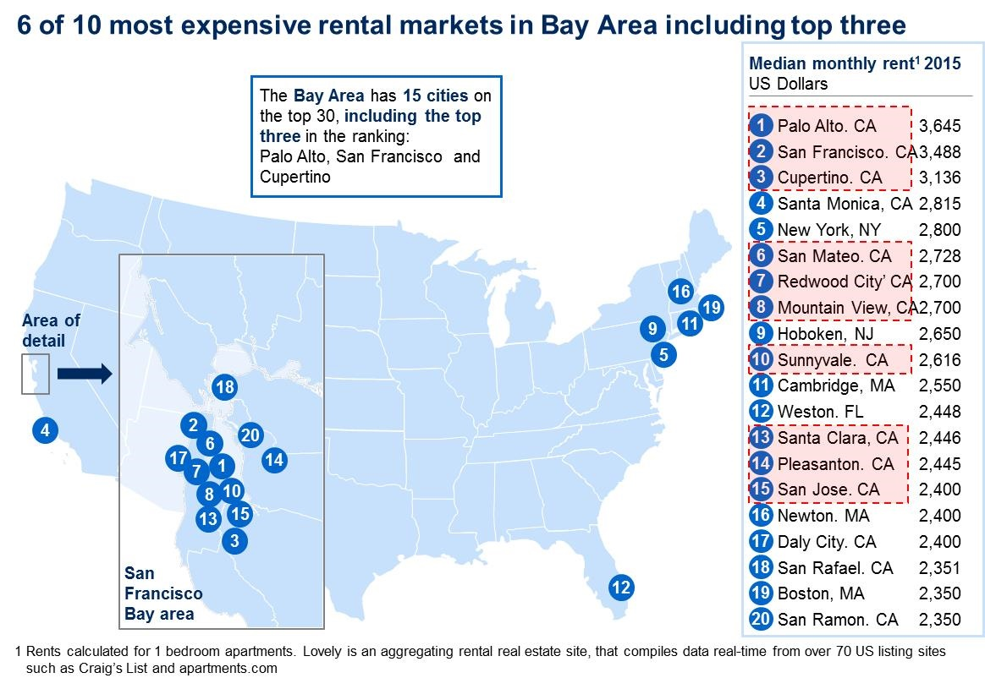
Notes:
Who is shocked by this?

Slide 7
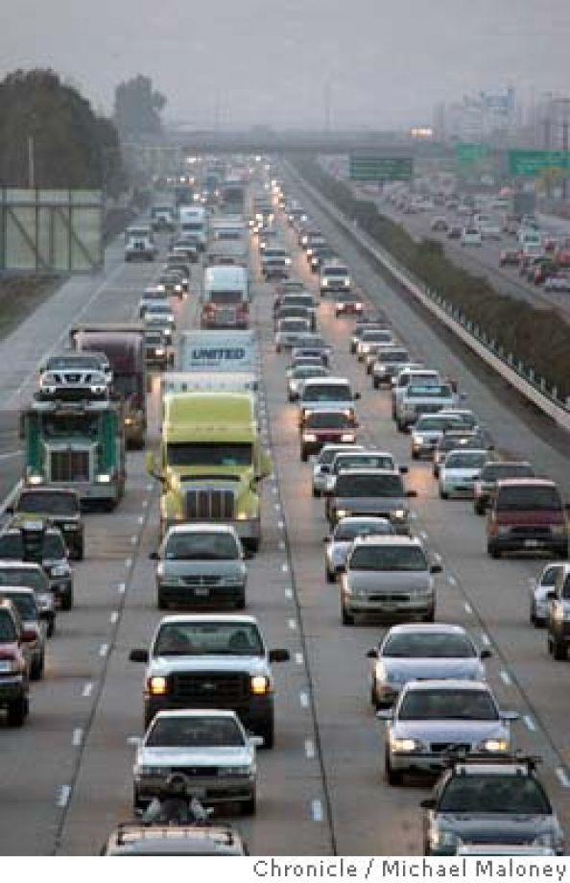
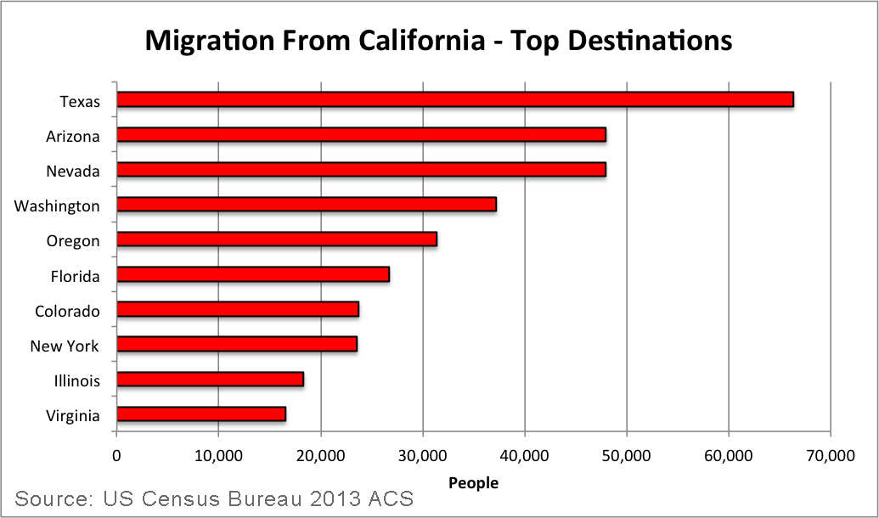
ENVIRONMENTAL CONSEQUENCES
Notes:
People move to the exurbs and commute to their jobs in the Bay Area. 170,000 incommuters…mega commuters. 40% of GhGs in CA come from cars stuck in long commutes. SB 375 is supposed to reduce VMT…it is not working. VMT is going up.
People also move to other states.

Slide 8
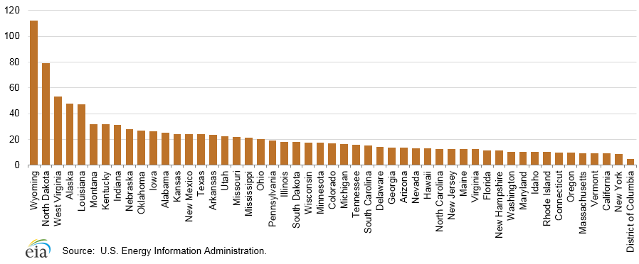
Per Capita GhG Production by State
Notes:
I was able to grab this data last week before the Department of energy website stopped posting anything to do with climate change. Per capita GhG in CA is 9 tons, in TX its 26 tons. Almost 70,000 people are leaving CA for TX each year for lower housing costs. CEQA is bad for the environment. Zero Net Energy is bad for the environment. Mandatory rooftop solar is bad for the environment. These are not “alternative facts”. Anything that increases the cost of housing in CA and forces a family to Texas is bad for the environment. Not only are we forcing people out of state seeking cheaper housing, we are forcing much of our middle income employment base out of state too. Jobs are leaving. This is called carbon leakage and our housing policies and environmental policies are making it happen.

Slide 9
Economic Consequences
Source California Legislative Analysts Office
Notes:
Jamba Juice left Emeryville for Texas last year, taking 400 middle income jobs, citing the inability to pay workers what is needed in the Bay Area to make rent. Charles Schwab closed their customer service center in SF and moved to Colorado for the same reason. All the chip manufacturing that used to happen here in the Valley is now in southern Oregon. I could continue citing examples for a while.

Slide 10
EQUITY CONSEQUENCES
California’s High Housing Costs drive out poor; middle-income workers.
Los Angeles Times Jan 1, 2015
Notes:
What kind of people are leaving California and who is replacing them?

Slide 11
Top Unemployment Blackspots in US
McAllen-Edinburg-Mission, TX Metropolitan Statistical Area | 7.1 | 372
Stockton-Lodi, CA Metropolitan Statistical Area | 7.8 | 374
Farmington, NM Metropolitan Statistical Area | 7.9 | 375
Modesto, CA Metropolitan Statistical Area | 7.9 | 375
Yakima, WA Metropolitan Statistical Area | 8.3 | 377
Yuba City, CA Metropolitan Statistical Area | 8.8 | 378
Madera, CA Metropolitan Statistical Area | 9.0 | 379
Bakersfield, CA Metropolitan Statistical Area | 9.2 | 380
Fresno, CA Metropolitan Statistical Area | 9.3 | 381
Hanford-Corcoran, CA Metropolitan Statistical Area | 9.3 | 381
Merced, CA Metropolitan Statistical Area | 9.5 | 383
Ocean City, NJ Metropolitan Statistical Area | 10.5 | 384
Visalia-Porterville, CA Metropolitan Statistical Area | 10.8 | 385
Yuma, AZ Metropolitan Statistical Area | 16.7 | 386
El Centro, CA Metropolitan Statistical Area | 20.3 | 387
Footnotes (p) Preliminary (1) Area boundaries do not reflect official OMB definitions.
Note: Rates shown are a percentage of the labor force. Data refer to place of residence. Estimates for the current month are subject to revision the following month.
Notes:
We are forcing out poor people and people of color and replacing them with highly educated mostly white people. 10 of the top 15 unemployment blackspots in the NATION are in California. When housing costs are factored in California has the highest poverty rate in the nation. Our situation is a reflection of our values. We talk a lot about social equity in California, but we enact policies that benefit rich people and homeowners and shoulder more cost burdens on the poor and people living on the margins.

Slide 12
Over the past three decades, local barriers to housing development have intensified, particularly in the high-growth metropolitan areas increasingly fueling the national economy. The accumulation of such barriers – including zoning, other land use regulations, and lengthy development approval processes – has reduced the ability of many housing markets to respond to growing demand. The growing severity of undersupplied housing markets is jeopardizing housing affordability for working families, increasing income inequality by reducing less-skilled workers’ access to high-wage labor markets, and stifling GDP growth by driving labor migration away from the most productive regions.
Notes:
This is not a quote from the Heritage Foundation, or the Trump White House. This is from President Barack Obama’s chief economic advisor, Jason Fuhrman decrying the over regulation of the housing market and what it means for poor people and people of color.

Slide 13
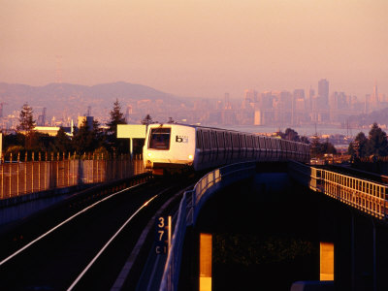
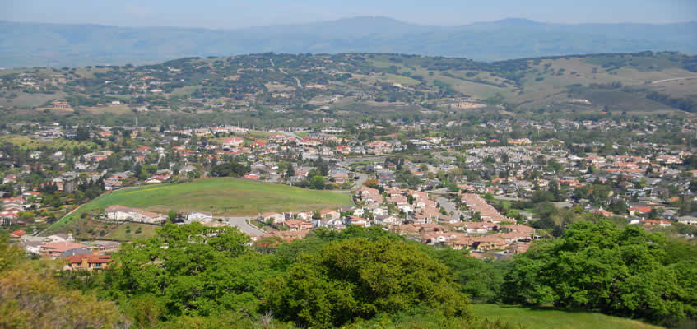
Thank you

