Slide 1
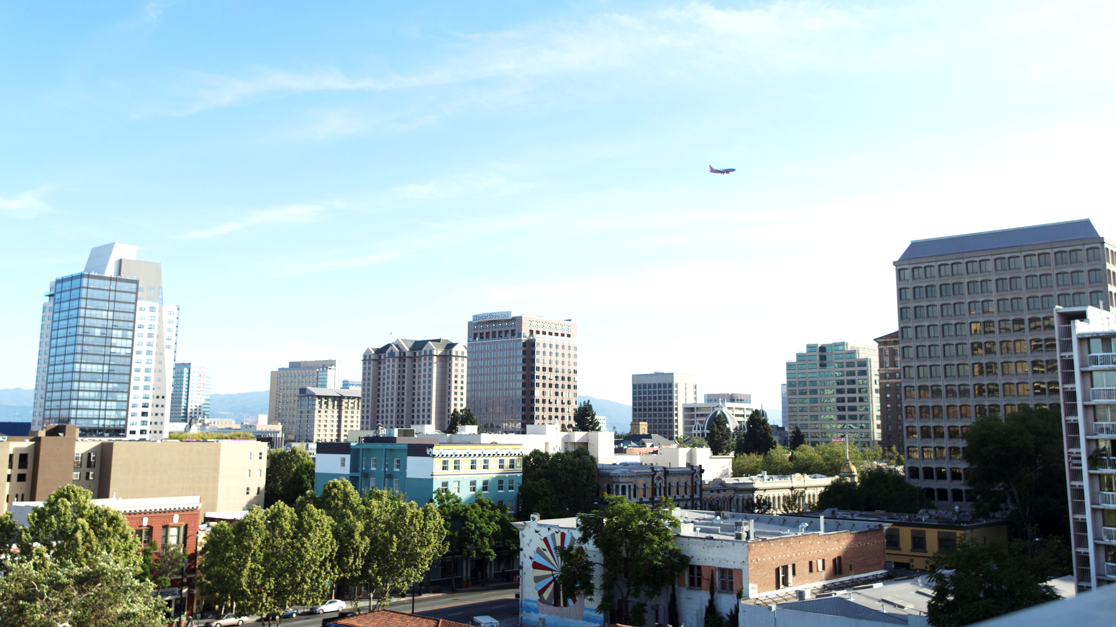
San Francisco Bay Area’s Chronic Housing shortfall long term challenge – requires a new approach
Image Source: https://www.flickr.com/photos/adamrschultz/8810617814
Ken Kirkey, MTC – January 28, 2017
Notes:
Introduction
Today, we are pleased to release the Draft Preferred Scenario for Plan Bay Area 2040, integrating both a future growth pattern for jobs and housing and a transportation investment strategy to complement that growth pattern. This release builds on the last year’s worth of work identifying targets, analyzing projects, comparing scenarios, and working with stakeholders.

Slide 2

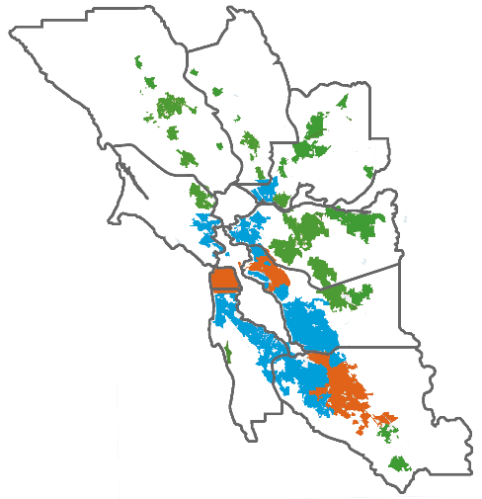


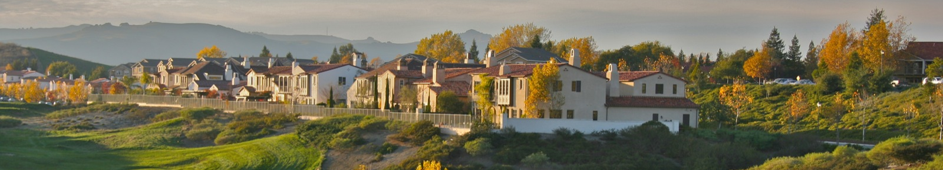
3
Our economy is booming – but we’re not building enough housing.
Jobs added from 2011 through 2015:
501,000
Housing units built from 2011 through 2015:
65,000
Big 3 Cities:
1 housing unit built for every
7 jobs created
Bayside Cities and Towns:
1 housing unit built for every
15 jobs created
Inland, Coastal, Delta Cities and Towns:
1 housing unit built for every
3 jobs created
Regionally: 1 house was built for every 8 jobs created
http://www.dof.ca.gov/research/demographic/reports/estimates/e-5/2011-20/view.php
Image Source: https://www.flickr.com/photos/swang168/388908005
California Department of Finance
Demographic Research Unit
Report E-5
Population and Housing Estimates for Cities, Counties, and the State, January 1, 2011-2016, with 2010 Benchmark
http://www.dof.ca.gov/research/demographic/reports/estimates/e-5/2011-20/view.php
Notes:
Plan Bay Area 2040 comes at a time of significant regional opportunities and challenges. Our booming job market – driven by Silicon Valley and San Francisco – has increased prosperity for many Bay Area residents. At the same time, affordability challenges have gotten worse – and have been exacerbated by a lack of housing production.
The region has done a good job creating new job but a poor job at building houses to accommodate that growth – especially in Bayside communities as highlighted on this slide. This has created affordability problems, which have then resulting in greater long-distance commuting between inland and bayside/”Big 3” locations. An example of this would be some cities on the Peninsula that have seen booming employment centers at companies like Google and Facebook, but many of their workers commute from the East Bay and San Francisco.
Colors represent where jobs and houses were built (referenced in the map graphic)
Orange – San Jose, San Francisco and Oakland
Blue – Bayside communities
Green – Inland, Coastal and Delta communities

Slide 3







Working within these constraints – and keeping this update limited and focused – we achieve 5 of the 13 ambitious targets.
8
Summary of the Draft Preferred Scenario Performance Target Results
Target Achieved (5)
Right Direction (5)
Wrong Direction (3)
Climate Protection*
Housing + Transportation Affordability*
Healthy and Safe Communities
Performance targets highlighted in this presentation are marked with an asterisk (*).
Adequate Housing
Affordable Housing
Displacement Risk*
Open Space and Agricultural Preservation*
Non-Auto Mode Shift*
Refer to Attachment A of the performance item for detailed results.
Access to Jobs
Middle-Wage Job Creation
Road Maintenance*
Note that target results are subject to change as scenarios are further refined this fall, and as scenarios are ultimately analyzed against the 2040 horizon year.
Goods Movement/ Congestion Reduction*
Transit Maintenance
Notes:
This means we are more constrained about what we can do on the land use front than on the transportation front. We want to develop a draft preferred scenario that moves the region forward towards its goals, but relies on policies that are considered feasible by local jurisdictions. We also want to develop a land use pattern that respects that this is a limited updated to the last Plan Bay Area – not a broad re-envisioning of how we should grow moving forward.
Working within this context, we developed the Draft Preferred Scenario you’ll hear about today. Ultimately, it met 5 of our very ambitious performance targets, moves in the right direction but falls short on five more, and moves in the wrong direction on 3 targets. The full breakdown of target results is included in your packet, but we will showcase seven targets in today’s presentation (marked in bold).

Slide 4
17
Accelerating housing production is critical to achieve this vision.
Notes:
Based on the control totals for housing growth, it is clear that housing production must accelerate to achieve this envisioned growth pattern. Only 65,000 units were constructed in the first five years of the forecast. Later five-year increments must take on growth 3x higher than the last five years.
One bright spot is that a good chunk of the housing envisioned through 2020 is already under construction as of 2016. This trend will need to continue and accelerate.

Slide 5
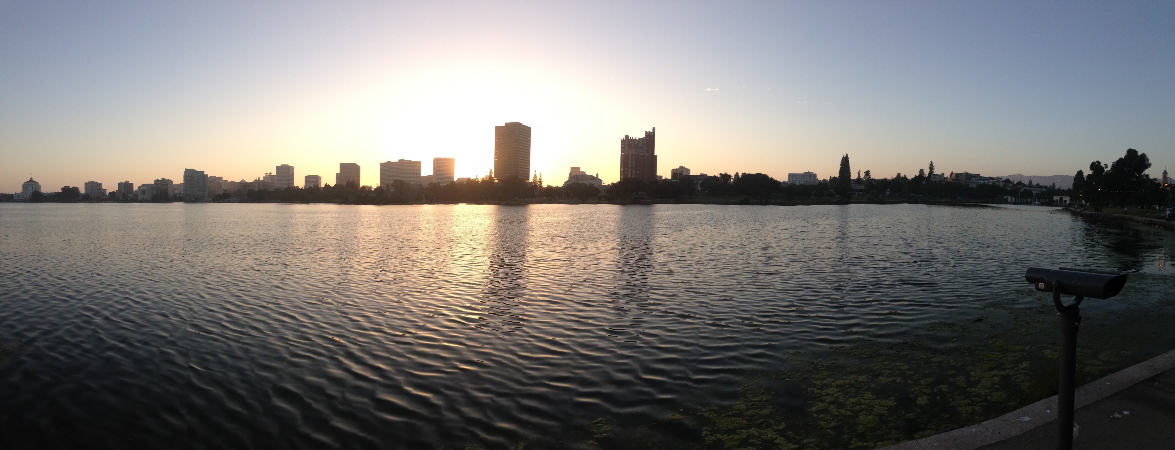

If we really want to address affordability and equity challenges, action is needed by an engaged public and by all levels of government. Only the most aggressive policies will be sufficient to deal with our housing crisis.
36
Housing: +12%
Housing + Transportation Costs
(as a share of income)*
54% of household income
67%
of household income
Transportation:
+1%
Housing + Transportation: +13%
2005
2040
* = for lower-income households
Image Source: https://www.flickr.com/photos/gdodge/15336815438
Notes:
But major challenges remain – primarily, affordability for all.
Housing + transportation costs as a share of household income are expected to rise significantly for all income levels. But lower-income households are most at risk – we estimate they will have to spend over 2/3 of their on those two categories alone by year 2040. And almost all of that cost increase comes from housing.
To address these challenges, action is needed. The public needs to be deeply involved if we want a region that is open and affordable to all, and if we want lower-income households to be able to live in the core of the Bay Area. As we have seen here, the policies in the Draft Preferred are not enough to slow this trend – much more aggressive action is needed to deal with the housing crisis.
There is certainly an opportunity to explore this more as we move towards the next Plan Bay Area, and through the work of the “blue ribbon” committee on housing expected in 2017.

Slide 6
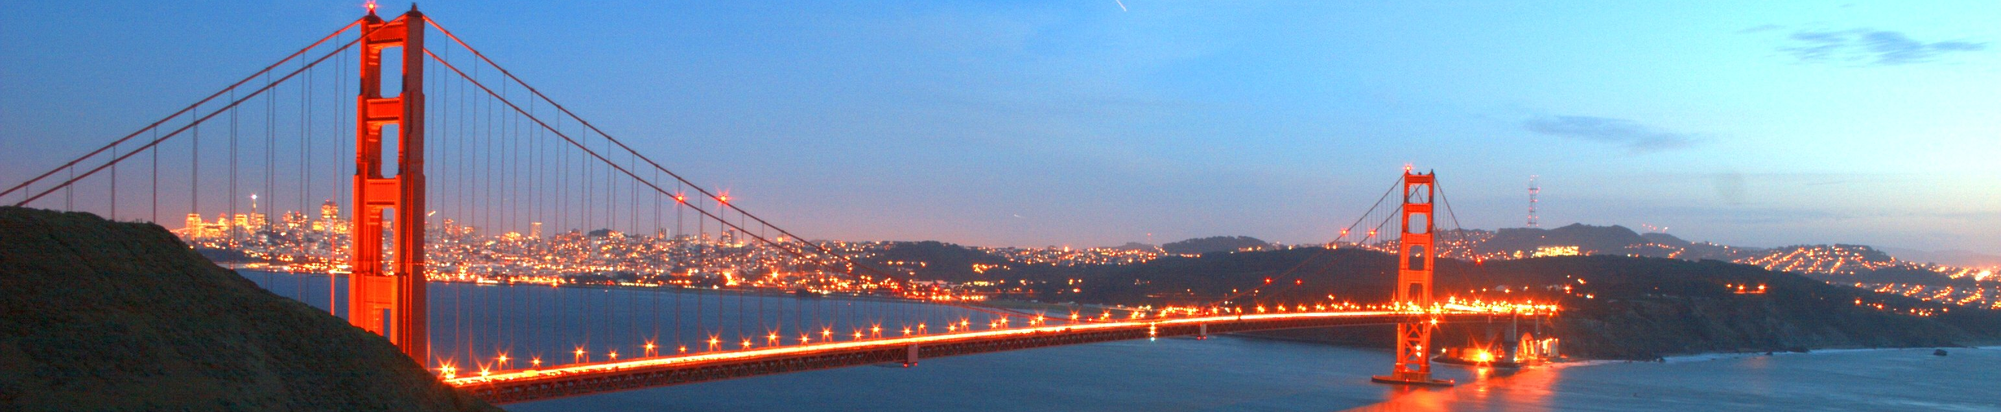
Fortunately, the region has significant resources for improving our transportation system – especially voter-approved sales taxes.
22
Revenue Envelope for Plan Bay Area 2040
$309 billion
Year of Expenditure $
Image Source: https://www.flickr.com/photos/beejjorgensen/3495038
Notes:
Compared to land use, the region is lucky to have significant resources at our disposal to operate and improve the transportation system. In part, this is thanks to voters who have opened their checkbooks time and again to approve sales tax measures in nearly every Bay Area county.
You’ll note that of the $309 billion in funding expected through 2040, less than 10 percent comes from the federal government, and over half of the funding is locally generated. It’s also important to recognize that the Draft Preferred Scenario revenue forecast relies upon ballot measures for this fall that have not yet been approved, and that if they are not passed, the investment strategy will need to be revised to reflect that.

Slide 7

Potential Tools:
- Bay Area Legislative Platform ?
- Regional Housing Trust Fund ?
- New TOD Policy for Discretionary $ ?
- Jobs Housing Linkage Fee ?
2017: CASA - Committee for Affordable and Sustainable Accomodations
- Bay Area Regional Strategy for Housing
37
Image Source: https://www.flickr.com/photos/arballoimages/9656613352
Notes:
And we want your feedback on this Draft Preferred Scenario in the short term as well.
We’ll be out meeting with city planning directors across the region this month to get their input on the land use and transportation strategies reflected in the scenario – we’ll take that feedback by mid-October and make revisions to the scenario as needed.
We will return to the committees in November seeking adoption of revised Preferred Scenario, which will also us to kick of CEQA analysis of that alternative.
All of this is designed for us to release a Draft Plan/EIR in the spring and approve a Final Plan/EIR next summer.
Questions?

